Slide 1
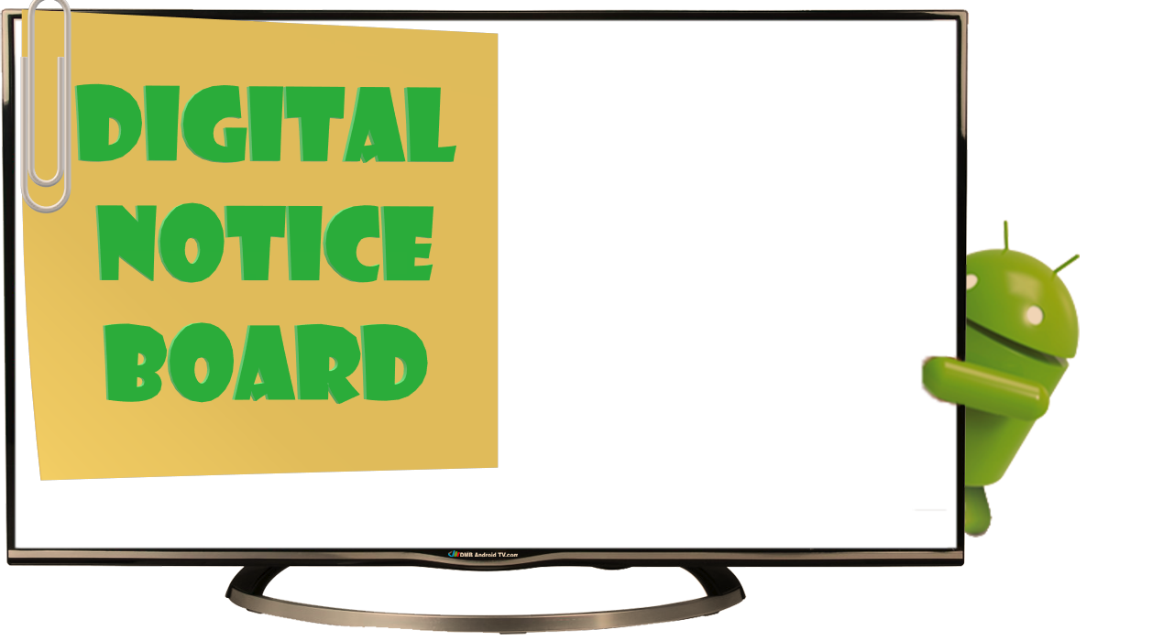

Welcome to Our Today’s PowerPoint
Which can provide You Information In Digital Format

Slide 2
Team Members
01
02
Jimit Patel
Shivam Patel
2018001166
2018001170
Designer & Coder
Designer & Coder

Slide 3
What is notice board ?
Before starts to explain current system let’s see first “ what is notice board ? “
It’s a way of communication in any type organization.
Way to share news, information, idea, updates, achievements, current trends, etc. to very large community in very less efforts.
It’s a place where people can updated itself to know about current affairs, updates etc. type latest information.
(reach at any place first we try to found information about place)

Slide 4



Importance of Notice Board ?
The best way to communicate at different organization level.
Educational With Students, staff, visitors.
Companies / firms
With Staff, team members, for inter department communication
.
Public places /
Tourism places
With visitors / Public.

Slide 5
Evolution of Notice Board
In previous era at any organization the black-board was a used as a notice board. on the black bord the latest updates, information could written by hand.
Now, days the black board can replaced by wall mounted notice board where generally notice available in form of the printed paper copy.
We want to take one step ahead and decided to developed the Digital notice board System. That contain notice in form of digital graphics.

Slide 6
Why Digital Notice Board required?
Now a days technology can changing the world very rapidly with that the demand of world also changed.
Everyone wants to know all information at a same time when they happed
There is certain problem occur with physical notice board.

Slide 7



Why Digital Notice Board ?
Limitations of Physical Notice Board
Insufficient space leading to overlapping posts.
It is hard to know the latest posts.
You cannot know how many people viewed your post.
It’s hard to get latest post during pandemic type situation.

Slide 8



Why Digital Notice Board ?
Not required the visiting the place for get notify.
Not required visited multiple notice board.
Now, days people more interested to get every thing on mobile.

Slide 9


Why Digital Notice Board ?
Introduction & Advantages
The Digital Notice Board System is Application, which automates the job of principal, hod’s, & support staffs.
The system will contain digital form of notice.
Instant information updates - no need to place notices or posters.
The user can view posts without necessarily visiting the wall notice board.

Slide 10



Why Digital Notice Board ?
Advantages of Digital Notice Board
  User can see search post by different categories wise
  User can get notification about new post so user never miss new notice update.
  Environmentally friendly - reduce paper.

Slide 11
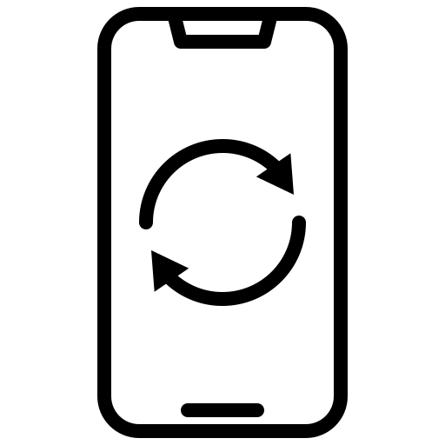
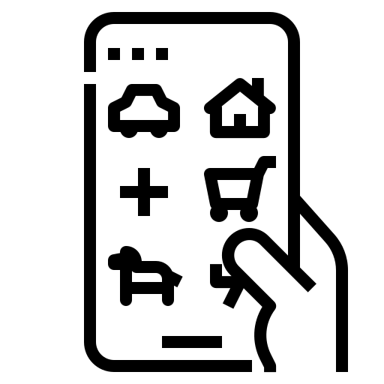

Why app not web ?
Now a days Mobile is part of life
Our goal is reached to max number of user.
Check updates on mobile app very easy.
Our max targeted audience is youngster student.

Slide 12


In app why go with Android ?
Global market share.
Budget friendly.
Students are not self dependent.

Slide 13
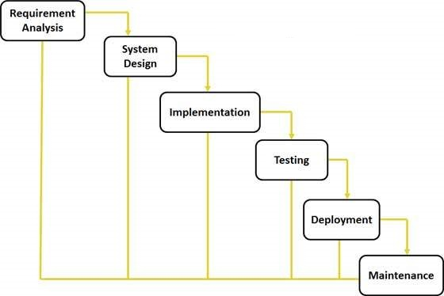
Model Used In development System (SDLC)
Waterfall Model

Slide 14



Digital Notice Board
Features Of Digital Notice Board
The application validates the authentic admin user by their id and password.
Admin can add new post & users can see all the posts added by the admin.
User and admin both can view other’s profile using search bar.

Slide 15



Digital Notice Board
Features Of Digital Notice Board
User get notification when any admin can upload notice on board so user can never miss the any update.
User’s can like & comment on the uploaded post’s.
User’s can save uploaded post for future use.

Slide 16

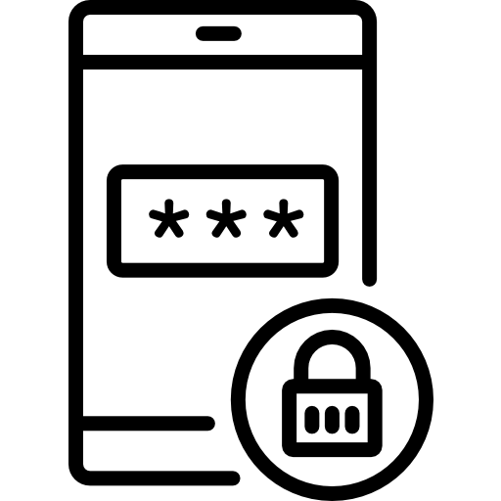
Digital Notice Board
Features Of Digital Notice Board
On notice board important notice , temporary notice can be add as story’s.
User & admin can update or re-set new password.
Validate user mobile number by sending OTP.

Slide 17
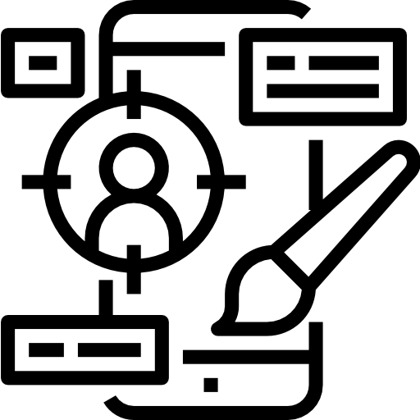

Technology Used
01
FRONTEND
ANDROID STUDIO
02
BACKEND
FIREBASE

Slide 18


Why We Choose These Technologies?
Frontend – Android Studio
The efficiency of Mobile Features.
User-Friendly Experience.
Instant App Run.
Push Notifications.

Slide 19


Why We Choose These Technologies?
Frontend – Android Studio
Visual Layout Editor.
Fast Emulator.
Intelligence Code Editor.
Help to Connect with Firebase.
Support KOTLIN.

Slide 20
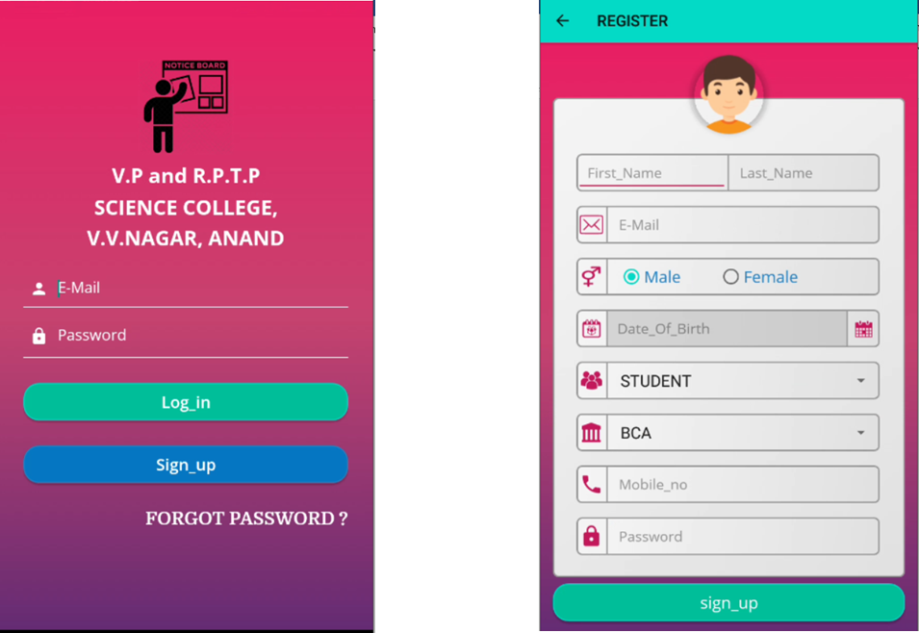
Screenshots

Slide 21
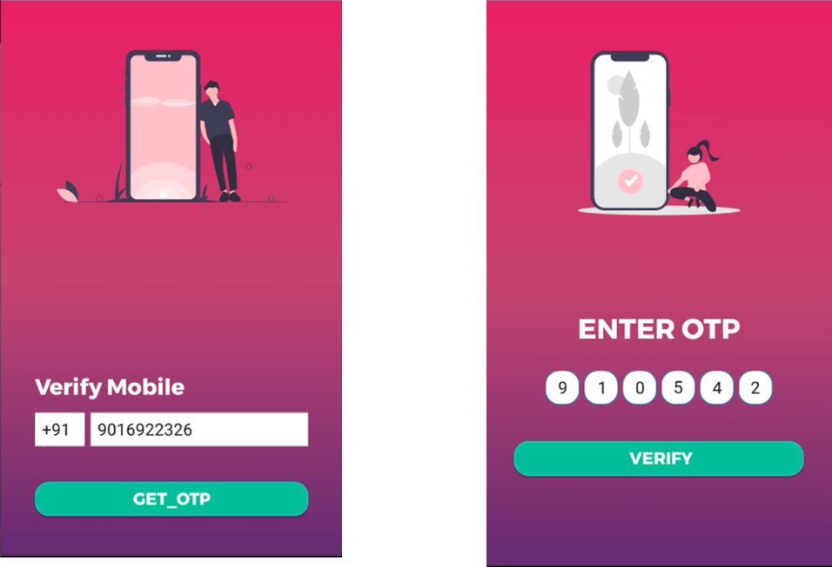
Screenshots

Slide 22
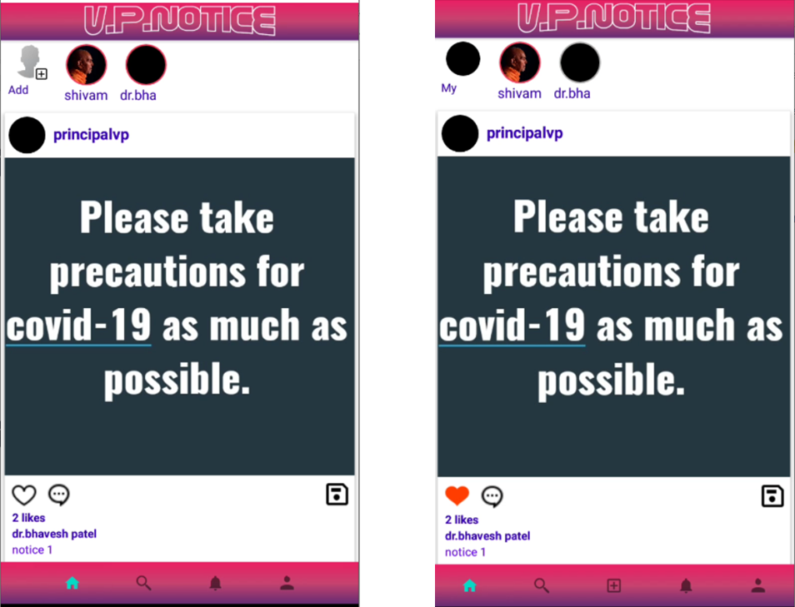
Screenshots

Slide 23
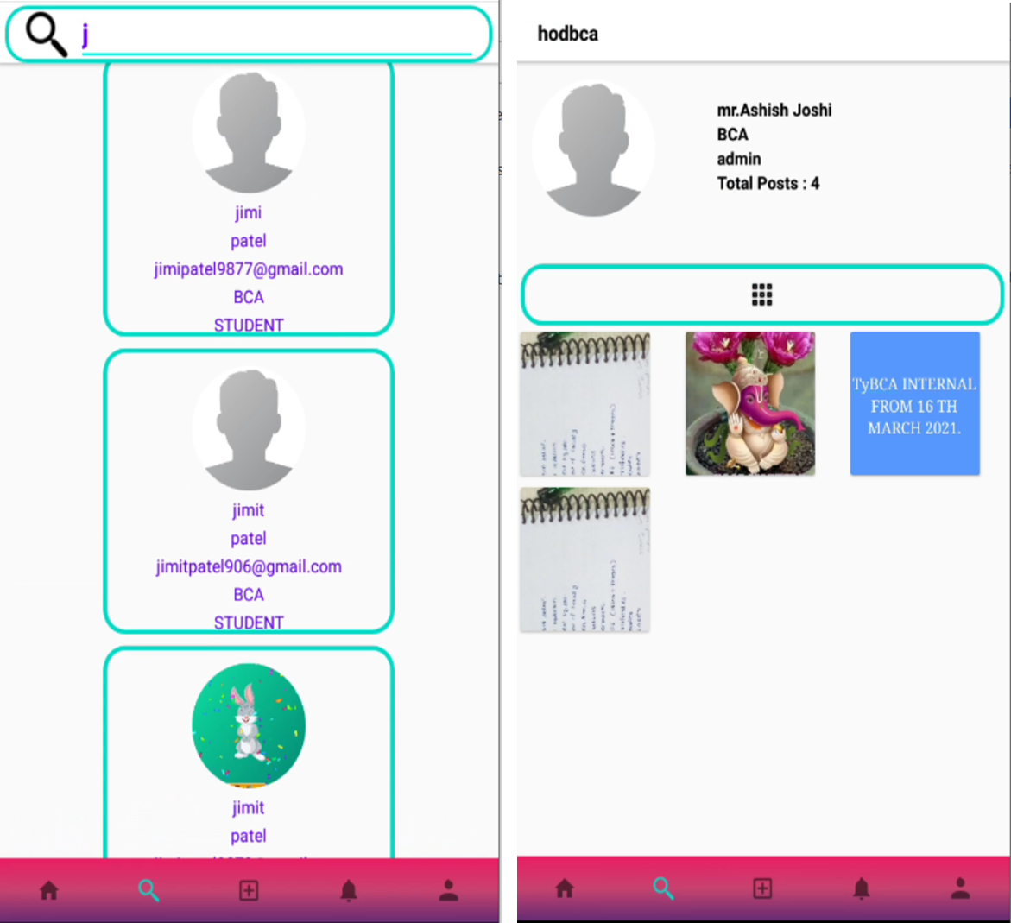
Screenshots

Slide 24

Why We Choose These Technologies?
Backend – Firebase
Real-time Database Helps to Store and Synchronize Data.
Firebase has Become Smarter with Google Analytics.
Firebase Authentication.
Send Notifications and Messages to Targeted Audiences.

Slide 25


Why We Choose These Technologies?
Backend – Firebase
Provides cloud Functions.
Cloud Firestore is a flexible, scalable database for mobile, web, and server development from Firebase and Google Cloud.
Firebase Crashlytics helps you track, prioritize, and fix stability issues that erode app quality, in realtime
Firebase Hosting provides fast and secure hosting for your web app, static and dynamic content, and microservices.

Slide 26
Backend Technology Used
Firebase
Tables Used
  ADMIN
  USER
  POST
  Saves
  Notification
  Story
  Comments
  likes

Slide 27
Future Enhancement
Due to time constraint and some further limitations we can not added some functionality in current application that we think we implements that all in nearest future.
Only admin can upload the story.
Improve app quality.
Handle number user at a time.
A master admin can add new admin registration.
Implement a push notification system.
Implement a search a previous post directly.

Slide 28

The further complete detailed related each &every phase included in development that described in project documentation
Thanks for Listening with great patience

